Slide 1

RUNGTA COLLEGE OF DENTAL SCIENCES & RESEARCH
INTRODUCTION OF PEDODONTICS
DEPARTMENT OF PEDODONTICS AND PREVENTIVE DENTISTRY

Slide 2

Specific learning Objectives
Core areas | Domain
Definitions Aims and objectives of pedodontics Worldwide history of pedodontics | Difference between child and adult patient Scope of pedodontics Changing trends of pedodontics

Slide 3
Catergory
MUST TO KNOW
NEED TO KNOW
AIMS AND OBJECTIVES OF PEDODONTICS.
DESIRE TO KNOW
INDIAN SOCIETY OF PEDODONTIC AND PREVENTIVE DENTISTRY.
IMPORTANCE OF PRIMARY TEETH.
PEDODONTIC TRIANGLE
SCOPE OF PEDIATRIC DENTISTRY.

Slide 4

CONTENTS:
Definitions
Aims and objectives of pedodontics
Worldwide history of pedodontics
Difference between child and adult patient
Pedodontic triangle
Modified pedodontic triangle
Scope of pedodontics
Changing trends of pedodontics

Slide 5
EVOLUTION OF PEDODONTICS IN INDIA:
  The foundation of pedodontics was laid down at Government dental college,Amritsar in 1950.
  Robert Bunon is the father of Pedodontics.
  BR Vacher is the father of Pedodontics in India.
  The association of Indian Pedodontists held its first conference on 24th of November 1979 where it was named as Indian Society of Pedodontia.

Slide 6
American academy of Pediatric dentistry (1999):
“Pediatric dentistry is an age-defined speciality that provides both primary and comprehensive, preventive and therapeutic oral health care for infants and childern through adolescence,including those with special health care needs”.

Slide 7
Aims and objectives :
Health of a child as a whole: As a pedodontist the overall health of the child should be of prime concern. Our aim is to improve dental health always in accordance with general health of the patient.
Prevention :while dealing with a child patient at an early stage in life prevention should be the prime object rather than treatment.

Slide 8
  Comprehensive oral health care: while selecting a treatment modality a pedodontist always focus on comprehensive oral health care of the child.
  The developing dentition: in a growing child needs to be monitored by pedodontist constantly from the beginning.
  A pedodontist needs to update his knowledge from time to time with the recent advancements.
  Instil a positive attitude: by instilling a positive attitude in children the pedodontist helps a child to grow into better dental patient for the future.

Slide 9
Pedodontics in India:
1920 | Calcutta Dental College and Hospital | 1st dental college started by Dr. Rafiuddin Ahmed, “Father of dentistry in India.”
1935 | BDS | Licentiate in Bacheolar of Dental Surgery.
1950 | Pedodontics is introduced | Government Dental College ,Amritsar,started Pedodontics as a speciality.
1978 | Pedodontics for undergraduates | Pedodontics is introduced as speciality in undergraduate curriculum.
1979 | Indian Society of Pedodontics and Preventive dentisrty | The association of Indian Pedodontics holds the 1st conference ;DrBR Vacher is made the “Father of pedodontics in India.’
1982 | Affiliated to IADC | Indian Society of pedodontics and Preventive Dentistry becomes an affiliate member of IADC.

Slide 10

DIFEERENCE BETWEEN CHILD AND ADULT PATIENT:
Hippocrates in the 5th century BC talked about the differences between child and adult.
Celsius recognized that the child must be treated differently from adults.
A child differs from an adult in varius ways-
Physical
Emotional and psychological
Consideration of behaviour
Treatment considerations.

Slide 11
Physical differences:
Anatomy – a child’s upper respiratory tract is predispose to obstruction at various sites because of narrow nasal passages,tongue,oral cavity disproportions and decreased airway diameter characteristics of infants and young adults.
In resting position a 20-30degree head tilt position is best for treating a child.

Slide 12
Physiology : alveolar ventillation (AV) is greater in a child but functional residual capacity (FRC) is lesser ,volume of remaining gas concentration after normal respiration is less.
AV/FRC decides the changes in inspired gas concentration .child reacts more rapidly to inhaled gases.

Slide 13
Cardiovascular system:
Physiology- heart rate averages 120 beats in newborn, decreases throughout childhood value by 10-12 years.
Cardiac output-heart rate and stroke volume-stroke volume is low due to insufficiency of left ventricle ,so cardiac output depends mainly on heart rate in children.
This age group is more prone to bradycardia as parasympathetic tone is more here.

Slide 14
Emotional and psychological differences:
In a child patient a lower of psychological competence is expected.
While treating a child his attachment to parents should be considered.
Children having lesser logic and cognition.

Slide 15
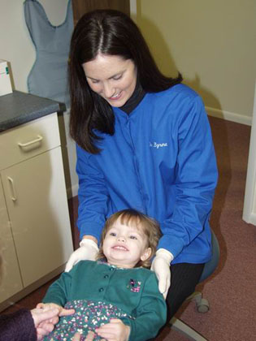
DENTIST PATIENT RELATIONSHIP
  The dentist must be able to handle children well.
  Perform to the best of his ability.

Slide 16
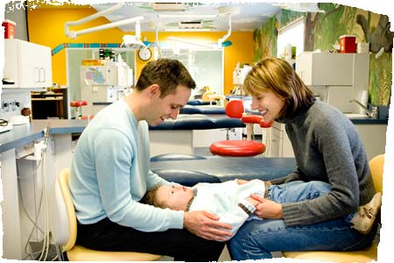
PARENT DENTIST RELATIONSHIP
  Dentist should be able to convince the parents that good dentistry for children is an investment in future health
  Good dentistry does not begin at dental chair, it begins at home .
  Proper oral hygiene
  Adequate diet
  Carbohydrate restriction
  Participating in community
  Programs.

Slide 17
Pedodontic triangle:
Patient-doctor relationship in Pedodontics is triangular.
In Pedodontics, the parent and child both are involved and child is at apex of the triangle.
It is given by GZ Wright in 1975.

Slide 18
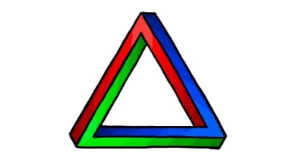

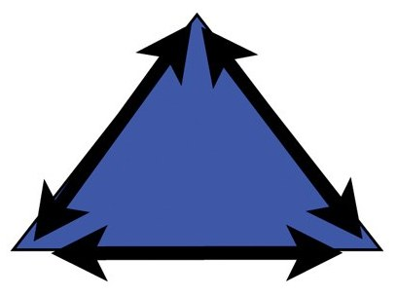


Conventional model

Slide 19
Modified model:
As community has become a major part of all components of environment therefore, recently a new parameter has been added that is society.
It was modified by McDonald et al in 2004.
Hence society came into center of the triangle indicating society are important factors influencing treatment modalities.

Slide 20
Society

Slide 21
Scope of Pediatric Dentistry:
Pedodontics encompasses a variety of disciplines,techniques,procedures and skills that logically share a common basis with other specialities but more modified transformed or adopted to special needs of childern.
A pedodontist also holds the privilege of being the first person to diagnose the earliest signs of any systemic disorder, which are manifested more frequently in a child oral cavity as compared to adults.

Slide 22
The scope of pediatric dentistry virtually includes the essence of all branches of dentistry like diagnosis, oral surgery,rehabilitation,endodontics,orthodontics,preventive dentistry and also includes the newer avenues like lasers and nanodentistry.

Slide 23
Changing trends of Pedodontics:
The various factors are responsible for this are-
Professional and public recognition of dental health for the general well being of the child.
Wide recognition of fluorides as the most effective health agent in the prevention of dental caries .
Introduction of high speed technology in the preparation of teeth requiring restoration.

Slide 24
Great improvement of various anesthetic agents in clinical use.
Introduction of the system of sophisticated plastics,i.e. composites,iuonomer cements, compomer,pit and fissure sealants-now popularly called as “invisible fillings”.
Radical changes to control virulent infections in any clinical contents.

Slide 25
The present trends in Pediatric dentistry:
Preventive dentistry & Public health denistry.
Child psychology and management.
Advanced restorative dentistry.
Preventive and interceptive dentistry.
Special care dentistry.
Child abuse and neglect (Forensic Pedodontics).
Genetics in pediatric dentistry.

Slide 26
Take Home Message
Pediatric dentists have extended services to fullfill the needs of the special child.
It includes the physically,mentally and medically handicapped.
They also have the good fortune of being important team member in the children hospital.
Also management of cleft lip and palate and patients and other such ailments.

Slide 27
References :
Textbook of Pedodontics-
Shobha Tondon
Textbook of Pediatric dentistry-
Nikhil Marwah
Textbook of pedodontics-
S.G. Damle

